Slide 1
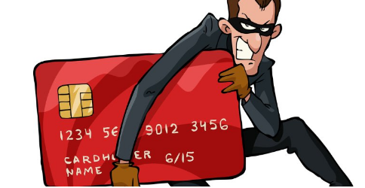
Credit Card Fraud Detection
MITESH REGE - 201903038
DSPL LAB
Experiment 6 – Case Study
XIE TE IT
GUIDE :
Prof. Chhaya Dhavale

Slide 2
PROBLEM DEFINITION
Online payment does not require physical card.
Anyone who knows the details of the card can make fraud transactions. Card holder comes to know only after the fraud transaction is carried out
E-commerce and many other online sites have increased the online payment modes, increasing the risk for online frauds.
The main aim of the project is to design and develop a fraud detection method to overcome this problem.

Slide 3
OBJECTIVE
The objective of proposed system is to build Credit Card Fraud Detection System Using Machine Learning
Credit Card Fraud Detection is a typical sample of classification.
pre-processing data sets as well as the deployment of multiple anomaly detection algorithms such Decision tree,linear regression,Random Forest.
This Problem includes modelling past credit card transactions with the data of the ones that turned out to be fraud

Slide 4
HARDWARE AND SOFTWARE SPECIFICATION
· HARDWARE SPECIFICATION:
Windows 8 and higher
8 GB ram and
Min core i3 processor
· SOFTWARE SPECIFICATION:
Python Latest Version Installed on System
Google Colab or
Jupyter Notebook or
Virtual Studio Code

Slide 5
DATA SET DESCRIPTION
Dataset Link :
It contains transactions made by credit cards in September 2013 by European cardholders with in two days.
This dataset we have 492 frauds out of 284,807 transactions. The dataset is highly unbalanced, the positive class (frauds) account for 0.172% of all transactions.
Unfortunately, due to confidentiality issues, we dont have original features ,Features V1, V2, … V28 are the principal components obtained with PCA.
The only features which have not been transformed with PCA are 'Time' and 'Amount'.
https://www.kaggle.com/datasets/mlg-ulb/creditcardfraud

Slide 6
PROPOSED METHOD
The proposed techniques emphasizes on detecting Credit Card Fraudulent transactions whether it is a genuine/nonfraud or a fraud transaction
The approaches used to separate fraud and non-fraud are KNN, Logistic regression, Random forest .
Finally we will observe which approach is best for detecting credit card frauds. The system architecture has following steps given on next slide

Slide 7
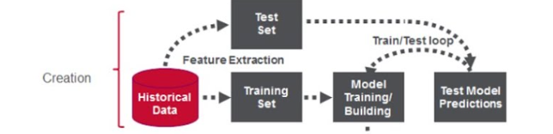
Project Work-Flow / Life Cycle
1.Import of Necessary Packages
2.Read the Dataset
3.Exploratory Data Analysis i.e. finding null values, duplicate values , data wrangling , transformation and also visualization etc.
4. Selecting Features (X) and the Target (y) columns train Test Split will split the whole dataset into train and test data
5. Build the model i.e. Training the model
6.Test the model i.e. Model prediction
7. Evaluation of the system i.e. Accuracy score, F1- score etc.

Slide 8
Algorithms Used
· K-Nearest Neighbor(KNN)
· Random Forest
· Logistic Regression
K-Nearest Neighbor
K-Nearest Neighbour is one of the simplest Machine Learning algorithms based on Supervised Learning technique.
K-NN algorithm stores all the available data and classifies a new data point based on the similarity. This means when new data appears then it can be easily classified into a well suite category by using K- NN algorithm.
Random Forest Algorithm
Random Forest is a popular machine learning algorithm that belongs to the supervised learning technique. It can be used for both Classification and Regression problems in ML. It is based on the concept of ensemble learning, which is a process of combining multiple classifiers to solve a complex problem and to improve the performance of the model.
Colab link :
https://colab.research.google.com/drive/1qplcohNAf1fLYFMgHWzsjbxkzcApiAvL?usp=sharing

Slide 9
Working of KNN AND Random Forest
The Working process of Random Forest can be explained in the below steps and diagram:
Step-1: Select random K data points from the training set.
Step-2: Build the decision trees associated with the selected data points (Subsets).
Step-3: Choose the number N for decision trees that you want to build.
Step-4: Repeat Step 1 & 2.
Step-5: For new data points, find the predictions of each decision tree, and assign the new data points to the category that wins the majority votes.
The K-NN working can be explained on the basis of the below algorithm:
Step-1: Select the number K of the neighbors
Step-2: Calculate the Euclidean distance of K number of neighbors
Step-3: Take the K nearest neighbors as per the calculated Euclidean distance.
Step-4: Among these k neighbors, count the number of the data points in each category.
Step-5: Assign the new data points to that category for which the number of the neighbor is maximum.
Step-6: Our model is ready.

Slide 10
Logistic Regression AND Bagging classifier.
Logistic Regression
Logistic regression is one of the most popular Machine Learning algorithms, which
comes under the Supervised Learning technique.
It is used for predicting the categorical dependent variable using a given set of independent variables
Bagging classifier.
A Bagging classifier is an ensemble meta-estimator that fits base classifiers each on random subsets of the original dataset and then aggregate their individual predictions (either by voting or by averaging) to form a final prediction.
Such a meta-estimator can typically be used as a way to reduce the variance of a black-box estimator (e.g., a decision tree), by introducing randomization into its construction procedure and then making an ensemble out of it.

Slide 11
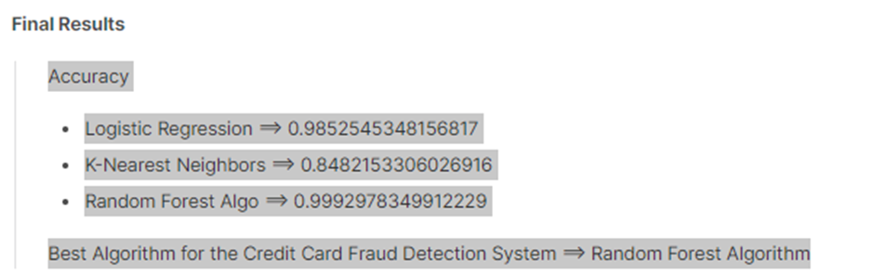
RESULT

Slide 12
CONCLUSION
Fraud Detection system have become essential for banks and financial institution to minimize their losses. We designed a system to detect fraud in credit card transaction.
This system is capable of providing most of the essential features required to detect fraudulent and legitimate transactions. After applying various algorithms We finally observed that random forest algorithm gave the highest accuracy.

Slide 13
THANK YOU !

